Slide 1
CS170 Review Session
7:00-9:00, Hearst Annex A1
Ray and Chris

Slide 2
Plan for the night
Practice problems

Slide 3
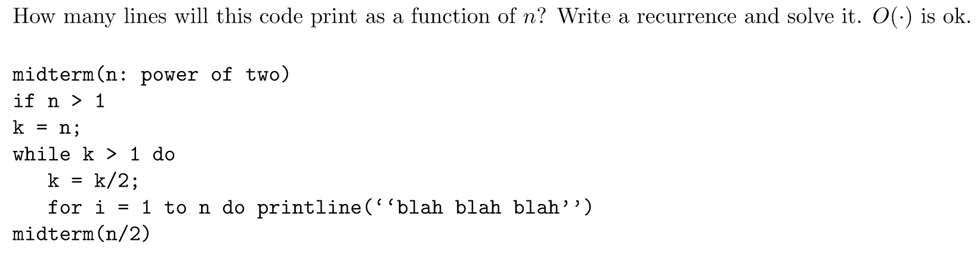
Recurrence Analysis (Sp 15, MT1)
Indentation error: Everything should be encapsulated by the if statement

Slide 4
Recurrence Analysis (Sp 15, MT1)
The while loop will print n * log(k) times. k=n. So the recurrence relation is:
T(n) = T(n/2) + O(n * log(n)). This is O(n * log(n)) (after expansion and bounding above and below). The bounding above and below is long, so not included here. Justification is available on a follow-up on Piazza’s MT1 Review thread.

Slide 5
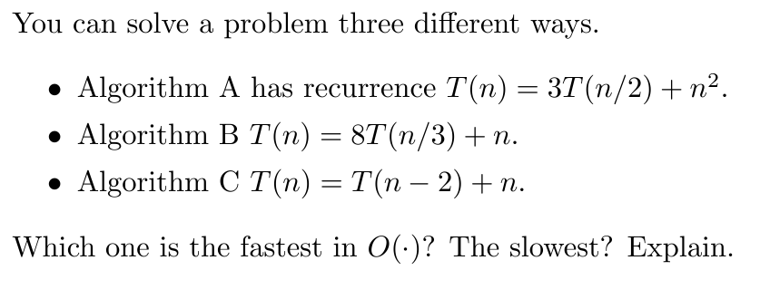
Recurrence Relations (Sp13 Mt1)

Slide 6
Recurrence Relations (Sp13 Mt1)
Algorithm A: T(n) = 3 * T(n/2) + n²
Using Master’s Theorem: log₂3 < 2. Thus T(n) = O(n²)
Algorithm B: T(n) = 8 * T(n/3) + n
Using Master’s Theorem: log₃8 > 1. Thus T(n) = O(n^{log_3 (8)})

Slide 7
Recurrence Relations (Sp13 Mt1)
Algorithm C: T(n) = T(n - 2) + n

Slide 8
Recurrence Relations (Sp13 Mt1)
Algorithm C: T(n) = T(n - 2) + n
T(n)
Work: O(n)
T(n - 2)
O(n - 2)
T(n - 4)
O(n - 4)

Slide 9


Recurrence Relations (Sp13 Mt1)
Algorithm C: T(n) = T(n - 2) + n
Asymptotically, algorithm B is fastest at Θ(n) and algorithms A and B are slowest at Θ(n²)
There are n/2 levels. Summing up the work at every level:
D df ≤ n * n = n²
^{Dfd dfdfd}
^{D} ≥ = n² /8
Θ(n²)
T(n)
Work: O(n)
T(n - 2)
O(n - 2)
T(n - 4)
O(n - 4)

Slide 10
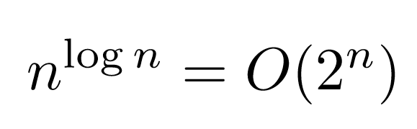
Some True/False (Sp 15, MT1)

Slide 11

Some True/False (Sp 15, MT1)
True
False, consider f(n) = (n^3) when n is odd, (n) when n is even. And g(n) = n^2

Slide 12
Topological Sort
Which of the following will give you a guaranteed valid topological sort for a DAG?
Order the nodes by prenumber
Order the nodes by reverse postnumber
Order the nodes by in-degree
None of the above

Slide 13
Topological Sort
Which of the following will give you a valid topological sort for a DAG?
Order the nodes by prenumber
Order the nodes by reverse postnumber
Order the nodes by in-degree
None of the above
B. Can you think of a counter-example for A and C?

Slide 14
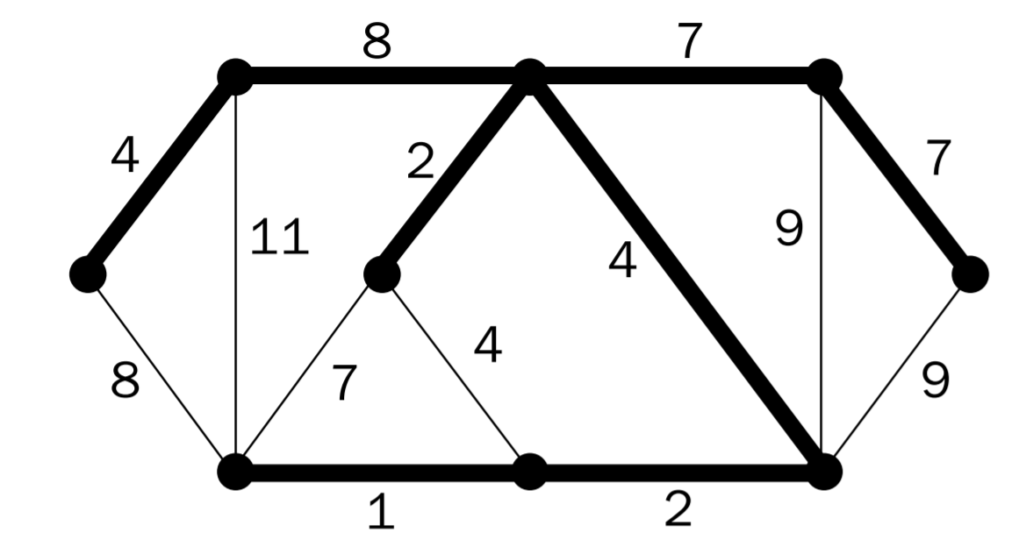
Kruskal’s MST (Fa 00, MT1)
The bolded edges are the MST edges as returned by Kruskal’s. Which edge must have been added last?

Slide 15
Kruskal’s MST (Fa 00, MT1)
The bolded edges are the MST edges as returned by Kruskal’s. Which edge must have been added last?
Kruskal’s adds edges from
smallest to biggest, so the
answer is 8.

Slide 16
MST vs. Shortest Path Tree (Fa 07, MT1)
True or false: We can find a connected undirected weighted graph G and a vertex V such that the minimum spanning tree and the shortest path tree rooted at V are disjoint. (Assume that the graph has a unique MST)

Slide 17
MST vs. Shortest Path Tree (Fa 07, MT1)
True or false: We can find a connected undirected weighted graph G and a vertex V such that the minimum spanning tree and the shortest path tree rooted at V are disjoint. (Assume that the graph has a unique MST)
False. For any graph, if we were to run Prim’s algorithm starting at V, we would add the shortest edge touching V to the MST. Similarly, if we run Dijkstra’s from V, we would add the shortest edge touching V to the shortest path tree. So in all cases, they would share at least one edge.

Slide 18
Dijkstra Modification (Fa 07, MT1)
We are given a directed graph with positive edge weights. We wish to find a shortest path from s to t, and among all shortest paths, we want the one in which the longest edge is as short as possible. How would you modify Dijkstra’s algorithm to this end?

Slide 19
Dijkstra Modification (Fa 07, MT1)
We are given a directed graph with positive edge weights. We wish to find a shortest path from s to t, and among all shortest paths, we want the one in which the longest edge is as short as possible. How would you modify Dijkstra’s algorithm to this end?
Dijkstra’s keeps a variable dist(u) to store the current shortest path distance to a node u, and prev(u) to store the last node needed to reach u in the shortest path found. Create a new variable long(u), which keeps track of the length of the longest edge.

Slide 20
More T/F (Sp 15, MT1)
If you increase the weights of all edges in a graph by 4, then the MST will stay the same.
If you increase the weights of all edges in a graph by 4, then the shortest path tree will stay the same.

Slide 21
More T/F (Sp 15, MT1)
If you increase the weights of all edges in a graph by 4, then the MST will stay the same.
If you increase the weights of all edges in a graph by 4, then the shortest path tree will stay the same.
True, the cost of every spanning tree goes up by exactly 4*(|V|-1)
False. Can you think of a counter-example?

Slide 22
DFS of a DAG

Slide 23
DFS of a DAG

Slide 24
T/F with a DAG

Slide 25
T/F with a DAG
False. There can be exponentially many distinct paths. Consider the linear ordering of a maximally connected DAG (every vertex has edges pointing to all vertices to the right of it). Then any vertex in between the source and the destination vertex can be in the path or not. This is 2^(|V| -2) paths.

Slide 26
T/F with a DAG

Slide 27
T/F with a DAG

Slide 28
T/F with a DAG
Every DAG has exactly one topological ordering

Slide 29
T/F with a DAG
Every DAG has exactly one topological ordering
False. Every DAG has at least one topological ordering. Can you think of an example?

Slide 30
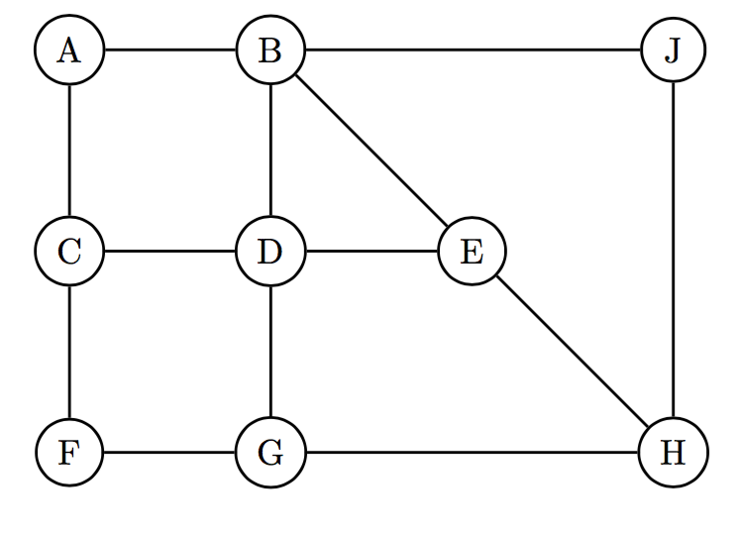
DFS (Fa15 Mt1)
Node | Pre | Post
A
B
C
D
E
F
G
H
J
Start at D and break ties alphabetically.

Slide 31
DFS (Fa15 Mt1)
Node | Pre | Post
A
B
C
D | 1
E
F
G
H
J
Recursive Stack: D

Slide 32
DFS (Fa15 Mt1)
Node | Pre | Post
A
B | 2
C
D | 1
E
F
G
H
J
T
Recursive Stack: D, B

Slide 33
DFS (Fa15 Mt1)
Node | Pre | Post
A | 3
B | 2
C
D | 1
E
F
G
H
J
T
T
Recursive Stack: D, B, A

Slide 34
DFS (Fa15 Mt1)
Node | Pre | Post
A | 3
B | 2
C | 4
D | 1
E
F
G
H
J
T
T
T
Recursive Stack: D, B, A, C

Slide 35
DFS (Fa15 Mt1)
Node | Pre | Post
A | 3
B | 2
C | 4
D | 1
E
F | 5
G
H
J
T
T
T
B
T
Recursive Stack: D, B, A, C, F

Slide 36
DFS (Fa15 Mt1)
Node | Pre | Post
A | 3
B | 2
C | 4
D | 1
E
F | 5
G | 6
H
J
T
T
T
B
T
B
T
Recursive Stack: D, B, A, C, F, G

Slide 37
DFS (Fa15 Mt1)
Node | Pre | Post
A | 3
B | 2
C | 4
D | 1
E
F | 5
G | 6
H | 7
J
T
T
T
B
T
B
T
T
Recursive Stack: D, B, A, C, F, G, H

Slide 38
DFS (Fa15 Mt1)
Node | Pre | Post
A | 3
B | 2
C | 4
D | 1
E | 8
F | 5
G | 6
H | 7
J
T
T
T
B
T
B
T
T
T
Recursive Stack: D, B, A, C, F, G, H, E

Slide 39
DFS (Fa15 Mt1)
Node | Pre | Post
A | 3
B | 2
C | 4
D | 1
E | 8 | 9
F | 5
G | 6
H | 7
J
T
T
B
T
B
B
T
B
T
T
T
Recursive Stack: D, B, A, C, F, G, H

Slide 40
DFS (Fa15 Mt1)
Node | Pre | Post
A | 3
B | 2
C | 4
D | 1
E | 8 | 9
F | 5
G | 6
H | 7
J | 10
T
B
T
B
T
B
B
T
T
B
T
T
T
Recursive Stack: D, B, A, C, F, G, H, J

Slide 41
DFS (Fa15 Mt1)
Node | Pre | Post
A | 3
B | 2
C | 4
D | 1
E | 8 | 9
F | 5
G | 6
H | 7
J | 10 | 11
T
B
T
B
T
B
B
T
T
B
T
T
T
Recursive Stack: D, B, A, C, F, G, H

Slide 42
DFS (Fa15 Mt1)
Node | Pre | Post
A | 3
B | 2
C | 4
D | 1
E | 8 | 9
F | 5
G | 6
H | 7 | 12
J | 10 | 11
T
B
T
B
T
B
B
T
T
B
T
T
T
Recursive Stack: D, B, A, C, F, G

Slide 43
DFS (Fa15 Mt1)
Node | Pre | Post
A | 3
B | 2
C | 4
D | 1
E | 8 | 9
F | 5
G | 6 | 13
H | 7 | 12
J | 10 | 11
T
B
T
B
T
B
B
T
T
B
T
T
T
Recursive Stack: D, B, A, C, F

Slide 44
DFS (Fa15 Mt1)
Node | Pre | Post
A | 3
B | 2
C | 4
D | 1
E | 8 | 9
F | 5 | 14
G | 6 | 13
H | 7 | 12
J | 10 | 11
T
B
T
B
T
B
B
T
T
B
T
T
T
Recursive Stack: D, B, A, C

Slide 45
DFS (Fa15 Mt1)
Node | Pre | Post
A | 3
B | 2
C | 4 | 15
D | 1
E | 8 | 9
F | 5 | 14
G | 6 | 13
H | 7 | 12
J | 10 | 11
T
B
T
B
T
B
B
T
T
B
T
T
T
Recursive Stack: D, B, A

Slide 46
DFS (Fa15 Mt1)
Node | Pre | Post
A | 3 | 16
B | 2
C | 4 | 15
D | 1
E | 8 | 9
F | 5 | 14
G | 6 | 13
H | 7 | 12
J | 10 | 11
T
B
T
B
T
B
B
T
T
B
T
T
T
Recursive Stack: D, B

Slide 47
DFS (Fa15 Mt1)
Node | Pre | Post
A | 3 | 16
B | 2 | 17
C | 4 | 15
D | 1
E | 8 | 9
F | 5 | 14
G | 6 | 13
H | 7 | 12
J | 10 | 11
T
B
T
B
T
B
B
T
T
B
T
T
T
Recursive Stack: D

Slide 48
DFS (Fa15 Mt1)
Node | Pre | Post
A | 3 | 16
B | 2 | 17
C | 4 | 15
D | 1 | 18
E | 8 | 9
F | 5 | 14
G | 6 | 13
H | 7 | 12
J | 10 | 11
T
B
T
B
T
B
B
T
T
B
T
T
T
Recursive Stack:

Slide 49
DFS (Fa15 Mt1)
Node | Pre | Post
A | 3 | 16
B | 2 | 17
C | 4 | 15
D | 1 | 18
E | 8 | 9
F | 5 | 14
G | 6 | 13
H | 7 | 12
J | 10 | 11
T
B
T
B
T
B
B
T
T
B
T
T
T
Since pre(D) is the smallest and post(D) is the largest, the graph is connected.

Slide 50
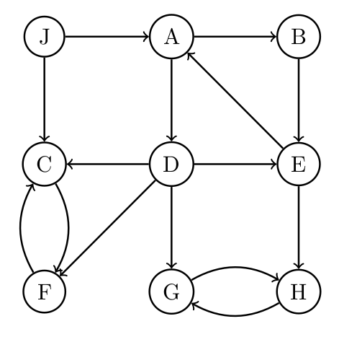
Find the SCC’s

Slide 51
Find the SCC’s

Slide 52
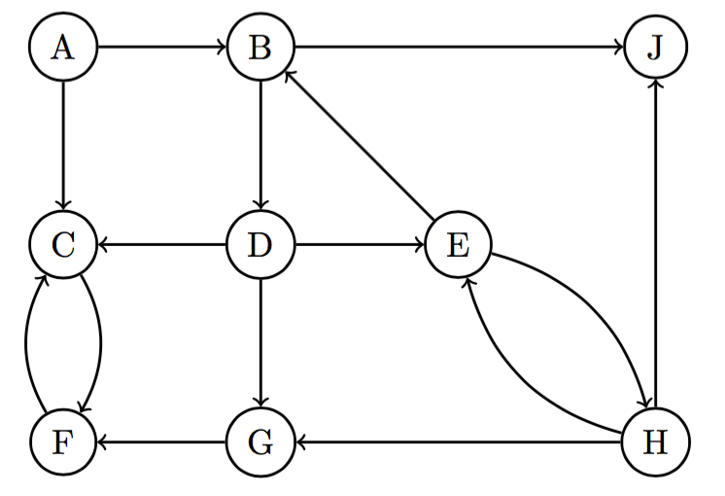
DAG of SCC

Slide 53
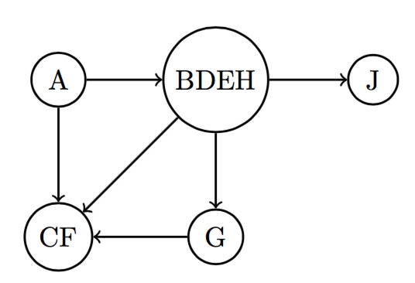
DAG of SCC

Slide 54
FFT
Suppose we want to evaluate a polynomial
A(x) = a₀ + a₁x + a₂x² + a₃x³
Need n ≥ d + 1 points to evaluate.
Choose the next power of 2. In this case we want 4 points, which will be the 4 roots of unity (1, -1, i, -i). Evaluate A(1), A(-1), A(i), A(-i).
Split A(x) = A_{e}(x²) + x * A_{o}(x²).
A(x) = (a₀ + a₂(x²)) + x * (a₁ + a₃(x²))
A_{e}(x) = a₀ + a₂x² and A₀(x) = a₁ + a₃x²

Slide 55
FFT
A(1) = A_{e}(1) + A_{o}(1)
A(-1) = A_{e}(1) - A_{o}(1)
A(i) = A_{e}(-1) + i * A_{o}(-1)
A(-i) = A_{e}(-1) - i * A_{o}(-1)
Only need to evaluate A_{e}(1), A_{e}(-1) , A_{o}(1), A_{o}(-1).
We went from evaluat 4 points of A(x) to 2 points of A_{e}(x) and 2 points of A_{o}(x).
That’s 2 recursive calls to problems of half the size. At each level, arithmetic takes O(n).
FFT Recurrence Relation: T(n) = 2 * T(n/2) + O(n) = O(n * log n)

Slide 56
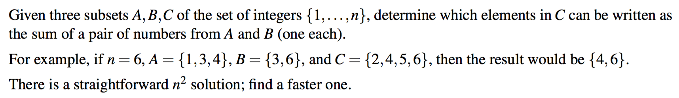
FFT (Sp16 Mt1)

Slide 57
FFT (Sp16 Mt1)
Multiplying polynomial adds exponents.
A(x) = Σ_{a}xª , B(x) = Σ_{b}x^{b}
Use FFT to obtain A(x) * B(x) = Σ_{a,b}x^{a + b}. For every nonzero coefficient term in this new polynomial, we check the power against set C and add it to our result if it is in C.

Slide 58
FFT (Sp16 Mt1)
Multiplying polynomial adds exponents.
A(x) = Σ_{a}xª , B(x) = Σ_{b}x^{b}
Use FFT to obtain A(x) * B(x) = Σ_{a,b}x^{a + b}. For every nonzero coefficient term in this new polynomial, we check the power against set C and add it to our result if it is in C.
Both A(x) and B(x) are n degree polynomials. A(x) * B(x) are 2n degree polynomials. Creating the polynomials takes O(n) time. Multiplication via FFT takes O(n log n). Checking the values against C takes O(n). Thus final runtime is O(n log n).

Slide 59
FFT (Sp16 Mt1)
Multiplying polynomial adds exponents.
A(x) = Σ_{a}xª , B(x) = Σ_{b}x^{b}
Use FFT to obtain A(x) * B(x) = Σ_{a,b}x^{a + b}. For every nonzero coefficient term in this new polynomial, we check the power against set C and add it to our result if it is in C.
Both A(x) and B(x) are n degree polynomials. A(x) * B(x) are 2n degree polynomials. Creating the polynomials takes O(n) time. Multiplication via FFT takes O(n log n). Checking the values against C takes O(n). Thus final runtime is O(n log n).
Power of nonzero coefficient terms are some combination of a_{i} + b_{j}. All the nonzero coefficient terms together forms all the combinations. So we can just check it

Slide 60
Algorithm Design: Divide and Conquer

Slide 61
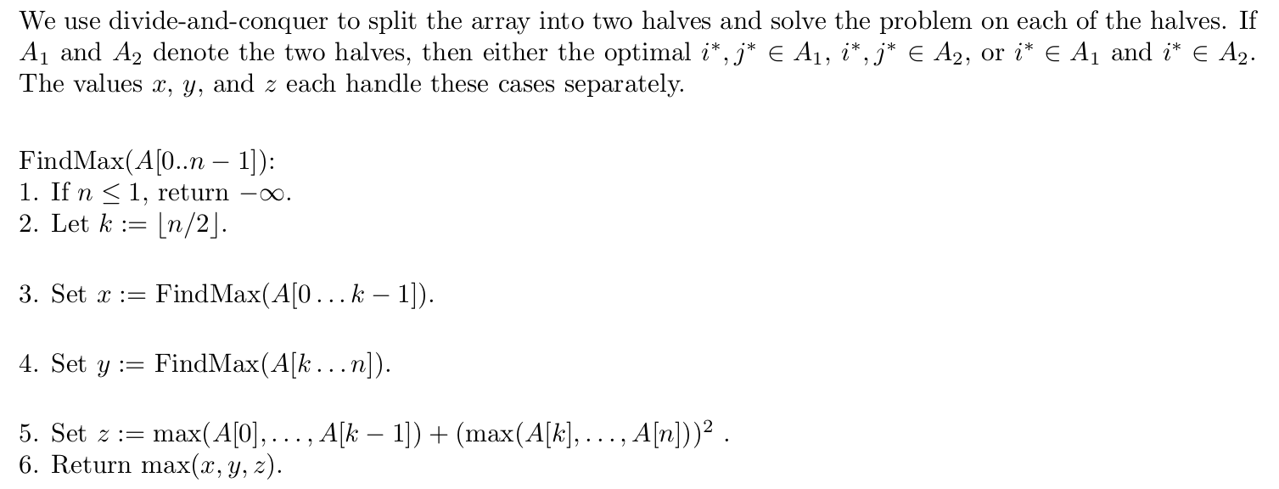
Algorithm Design: Divide and Conquer

Slide 62
Algorithm Design: No rules, go faster

Slide 63
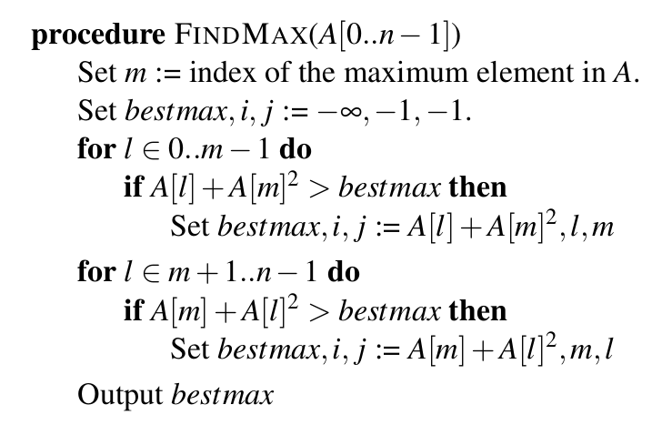
Algorithm Design: No rules, go faster

Slide 64
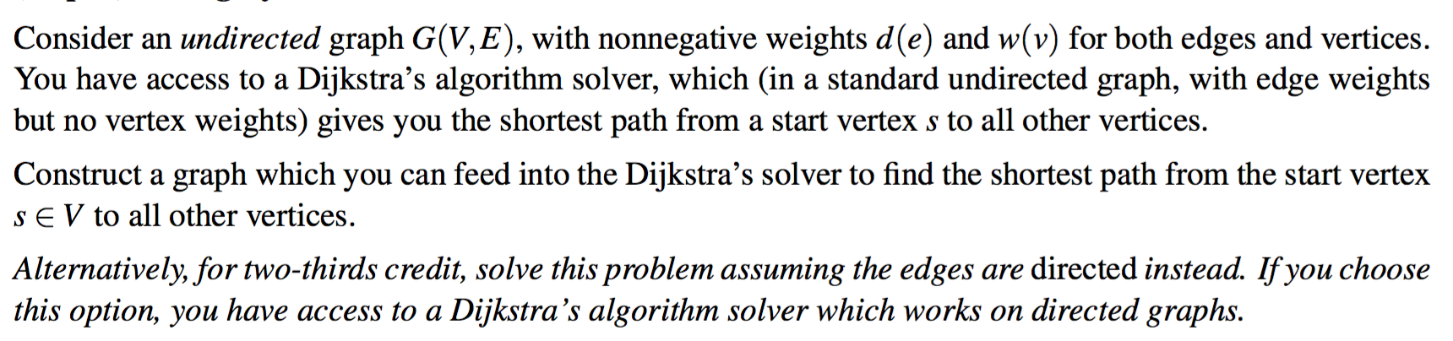
Weighty Vertices (Sp16 Mt1)

Slide 65
Weighty Vertices (Sp16 Mt1)
Hint: Think about what if the edges are directed instead?
How can we build off the directed solution for an undirected graph?

Slide 66
Weighty Vertices (Sp16 Mt1) - Directed
Force shortest path to add weight w(v) to distances if we use the vertex.
How to tell whether we have gone through a vertex?
w(v) = 5

Slide 67
Weighty Vertices (Sp16 Mt1) - Directed
Add weight w(v) if we use the vertex.
How to tell whether we have gone through a vertex?
w(v) = 5
d(e) = 5

Slide 68
Weighty Vertices (Sp16 Mt1) - Directed
Add weight w(v) if we use the vertex.
How to tell whether we have gone through a vertex?
For every vertex v, we split it into 2 vertices, v₁ and v₂.
Add edge (v₁, v₂) with weight w(v).
Run Dijkstra’s shortest path algorithm on the new graph.
If a shortest path goes through v₁ and v₂, then it must have gone through v in the original graph.
w(v) = 5
d(e) = 5

Slide 69
Weighty Vertices (Sp16 Mt1) - Undirected
What can we do for an undirected graph?
w(v) = 5
d(e) = 1
d(e) = 2
d(e) = 3
d(e) = 6

Slide 70
Weighty Vertices (Sp16 Mt1) - Undirected
What can we do for an undirected graph?
w(v) = 5
d(e) = 1
d(e) = 2
d(e) = 3
d(e) = 6
1
2
5
5
5
5
5
3
5
6

Slide 71
Weighty Vertices (Sp16 Mt1) - Undirected
What can we do for an undirected graph?
Create a vertex v_{i} for every edge incident to vertex v. Add an edge between every pair of v_{i}, v_{j} with edge weight w(v).
Run Dijkstra’s algorithm on this new graph.
Using any of the newly created edges means we’re using the vertex and taking into account the vertex cost.
Each vertex becomes a complete sub-graph to replicate the behavior of entering and leave the vertex using any undirected edge.
w(v) = 5
d(e) = 1
d(e) = 2
d(e) = 3
d(e) = 6
1
2
5
5
5
5
5
3
5
6

Slide 72
Weighty Vertices (Sp16 Mt1)
Alternative solution (undirected):
For every edge, add half of the vertex weights that the edge connects to the edge weight. d((a, b)) = w(a)/2 + w(b)/2 + d((a, b))
w(a) = 4
w(a) = 2
d(e) = 5
d(e) = 8
Alternative solution (directed):
For every edge, add the weight of the income vertex to the distance. d((a, b)) = d((a, b)) + w(b)/2
w(a) = 4
w(a) = 2
d(e) = 5
d(e) = 7

Slide 73
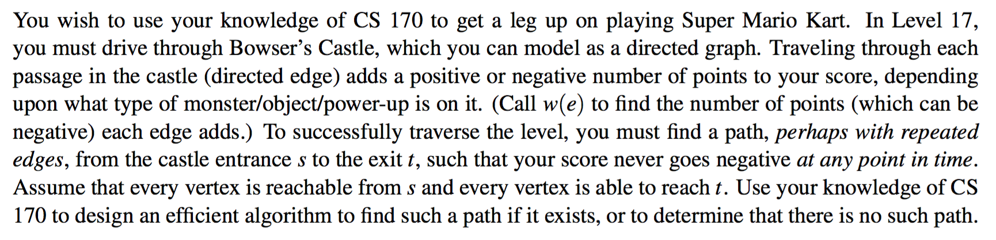
Super Mario (Hard)

Slide 74
Super Mario (Hard)
Since the number of points are edge weights, we want some path such that the accumulated points don’t become negative. We want some positive cycle.
Let’s modify Bellman Ford algorithm as this can find shortest (longest) paths with negative edge weights and deals with positive/negative cycles.
At each update, verify that the value of the path never becomes negative.
If there is a positive cycle from s such that the path does not become negative, there will be some legal path from s to t

Slide 75
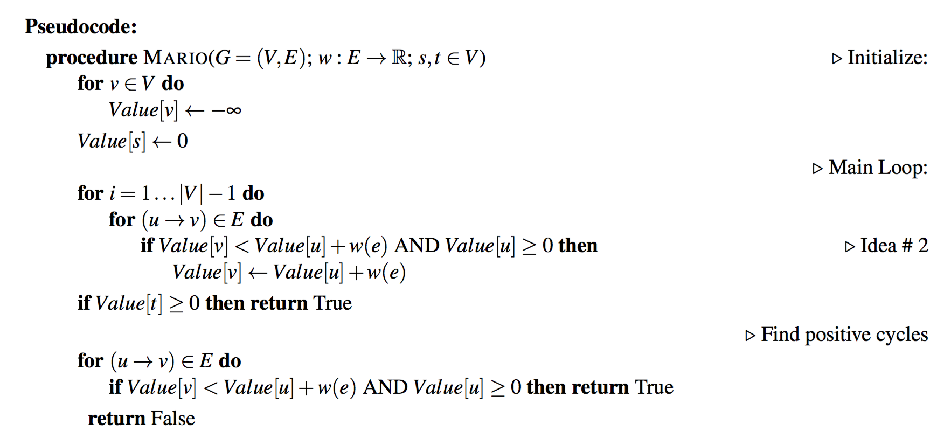
Super Mario (Hard)

Slide 76
Questions
Any topic that we should talk about now?

